Slide 1

Beyond Android Thomas Künneth
https://unsplash.com/photos/VYOrErmJes4

Slide 2
Let‘s recap
Jetpack Compose is Android‘s new native UI toolkit
It uses Kotlin functions
The UI is declared based on state

Slide 3
Compose hierarchies are hosted within activities or fragments
Compose can use resources, still not tightly coupled with rest of system
Distributed as a set of libraries – not part of the Android platform

Slide 4
Wouldn‘t it be cool to re-use Jetpack Compose skills on other platforms?
Flutter started as a mobile framework
Now embraces the Desktop and the Web, too
JetBrains thought it would 😎

Slide 5
Compose Multiplatform: fast reactive Desktop and Web UI framework
Based on Jetpack Compose
Based on Kotlin Multiplatform

Slide 6
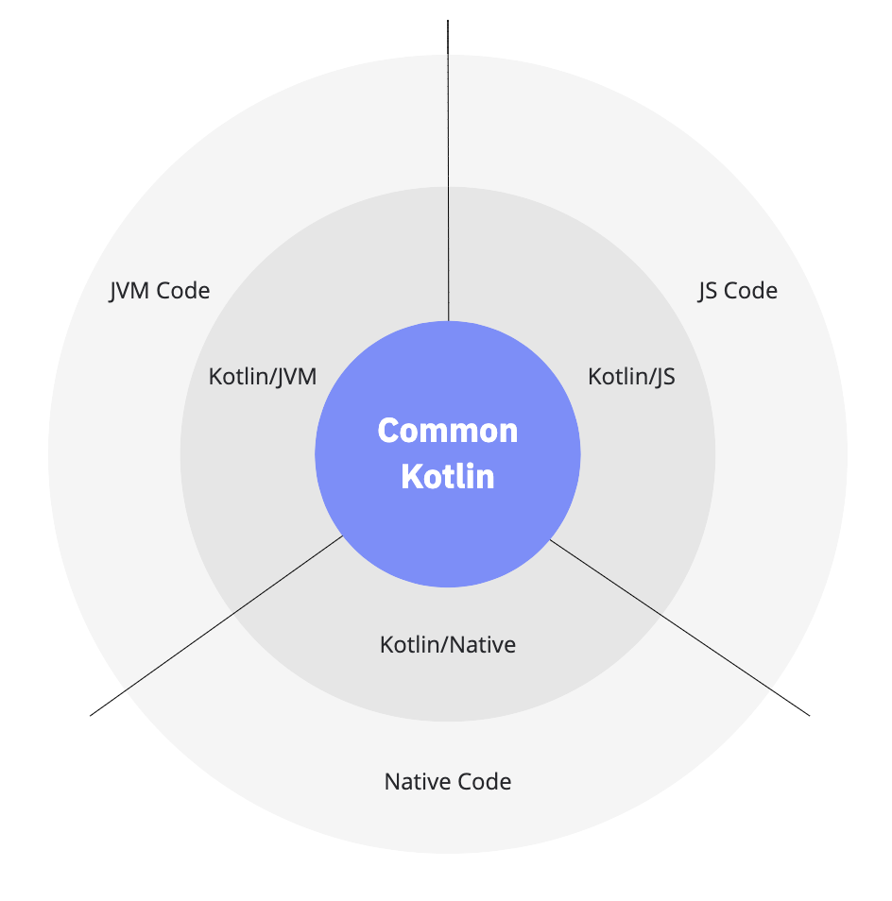
Kotlin Multiplatform: Apps for more than one platform
Plugin, Gradle integration
Project structure
Kotlin/Native: Apps for devices without a virtual machine
Target architecture
Integration
https://kotlinlang.org/docs/multiplatform.html#how-kotlin-multiplatform-works

Slide 7
Kotlin/Native
Compiles Kotlin into native code
LLVM-based backend for the Kotlin compiler
Provides
native implementations of the Kotlin standard libraries
interop to the platform
bindings for platform-specific libraries

Slide 8
Based on platform and target, Kotlin/Native creates
executables
static or dynamic libraries with headers for C and C++ projects
Apple frameworks for Objective-C and Swift projects
Kotlin code can consume
existing static or dynamic C libraries
Swift and Objective-C frameworks

Slide 9
Projects are structured using source sets
Typically two branches
main for the code
test for unit tests

Slide 10
Targets
Build, test, and package artefacts for a platform
Are fuelled by one or more source sets
Consist of one or more compilations

Slide 11
Compilations
Structure code regarding usage (test, production)
Standard compilations: main and test
Each compilation has a default source set
If needed custom compilations can be configured

Slide 12
Targeting multiple platforms
Try to re-use code across platforms
Only implement platform-specific features as platform-specific code

Slide 13
Common (shared) code is in kotlinMain
Platform specific code is in xyzMain
Kotlin supports implementing for more than one platform with expect and actual

Slide 14

Questions…?
Short break… 😍

